Slide 1
LAXMI INSTITUTE OF TECHNOLOGY, SARIGAM
Prepared By : Guided By
MOBIN.F.HUNANI Latesh Patel
ROLL NO.:- 61 Piyush Patel
BE, Sem-1, Electrical Engineering
Sub:-E.E.E.

Slide 2
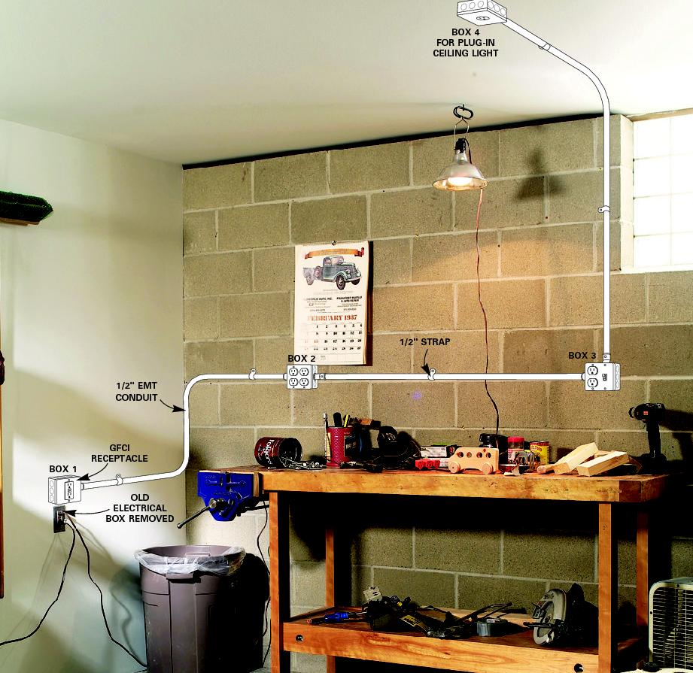
DIFFERENT
TYPES OF
WIRING

Slide 3
DIFFERENT TYPES OF INTERNAL WIRING
CLEAT WIRING
WOODEN CASING AND CAPPING WIRING.
C.T.S. OR T.R.S. WIRING.
LEAD SHEATHED OR METAL SHEATHED
WIRING.
CONDUIT WIRING.

Slide 4
CONDUIT WIRING
Introduction
In general, a conduit is defined as a tube or channel. Tubular conduit is the most commonly used material in electrical installations. When cables are drawn through the conduit and terminated at the outlet or switch points, the system of wiring is called conduit wiring.

Slide 5
TYPES OF CONDUITS.
There are four types of conduits used for wiring.
Rigid steel conduit
Rigid non-metallic conduit
Flexible steel conduit
Flexible non metallic conduit.

Slide 6
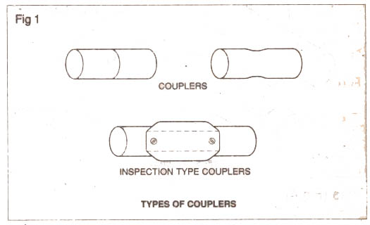
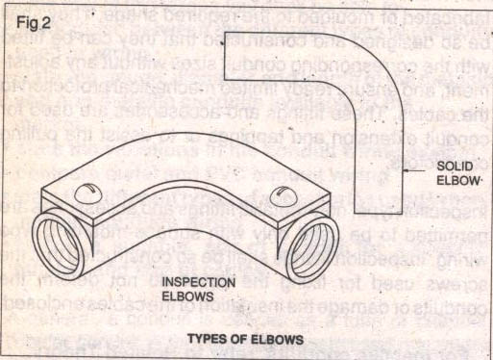
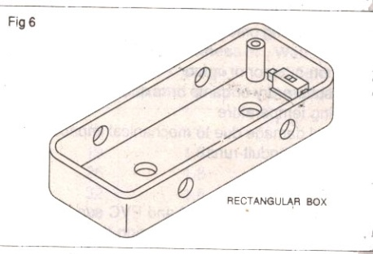
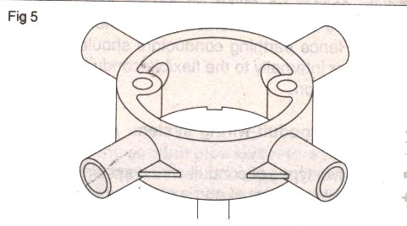
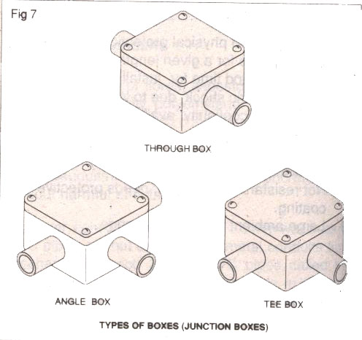
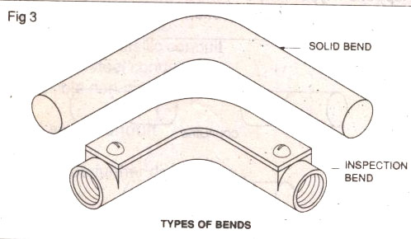
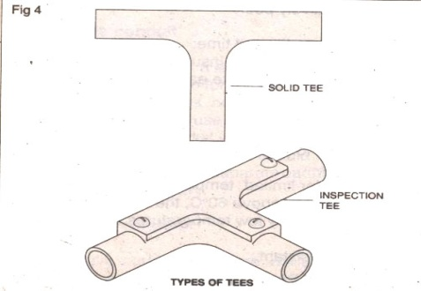
PVC Fittings and accessories couplers
Couplers
Elbow
Rectangular boxes
Circular boxes
Junction Boxes
Bends
Tees

Slide 7
Advantages:
The whole system is water proof.
Conductors are safely secured from moisture.
It has longer life.
Disadvantages:
It is costly system of wiring.
It requires more time for erection.
It requires highly skilled labour.

Slide 8
THANK YOU

